Slide 1
Machine Learning for Wastewater treatment

Slide 2
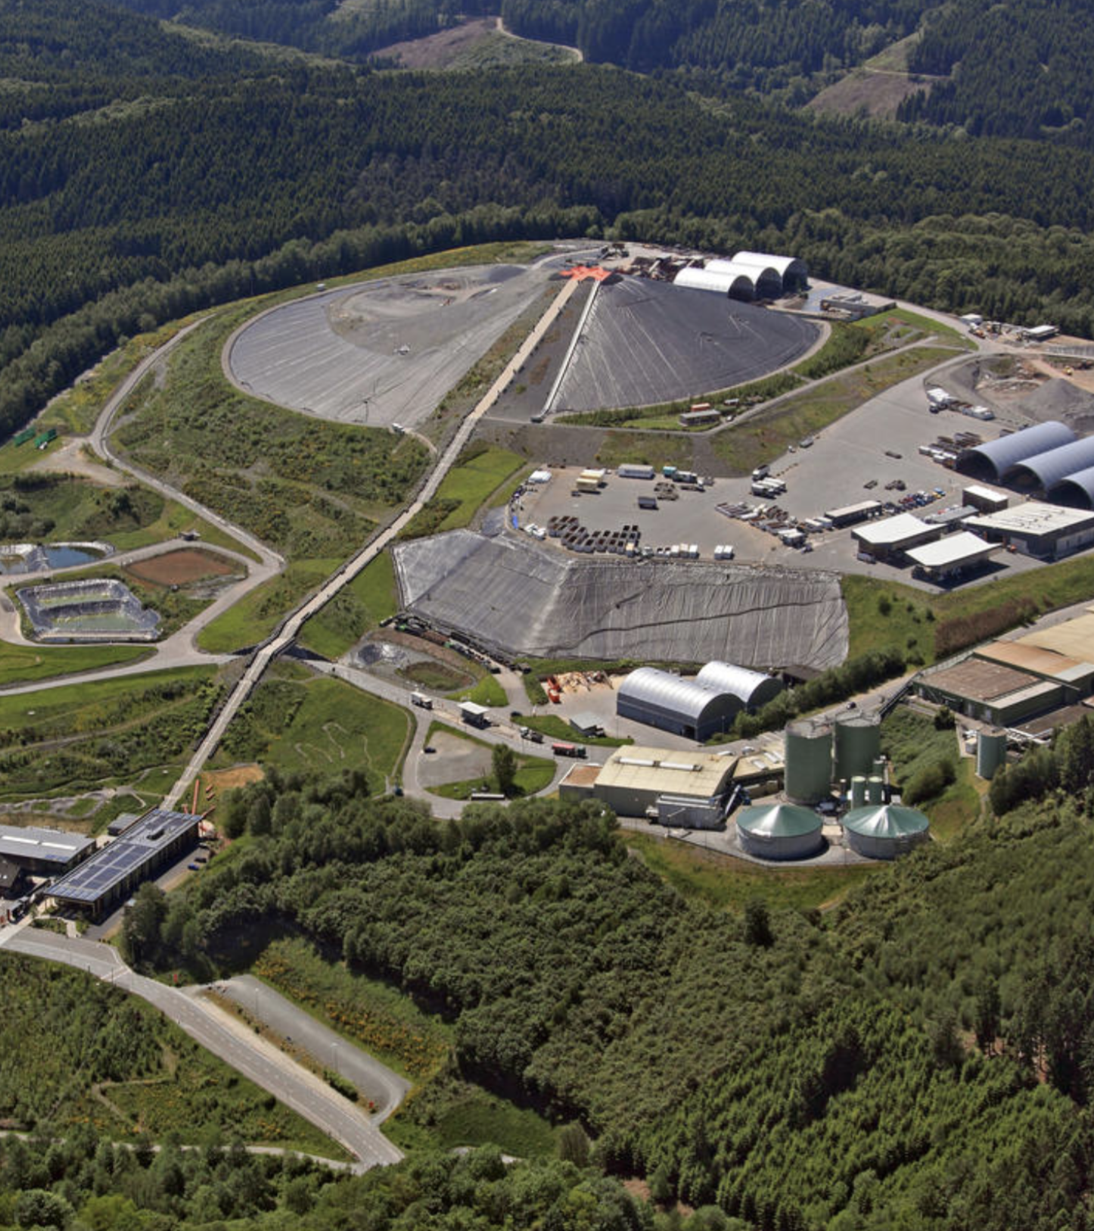
Introduction
Every year, about 120,000 tonnes of household waste are disposed of in German landfills

Slide 3

Introduction
During storage, highly contaminated wastewater leachate is produced.
1,500,000 / day

Slide 4
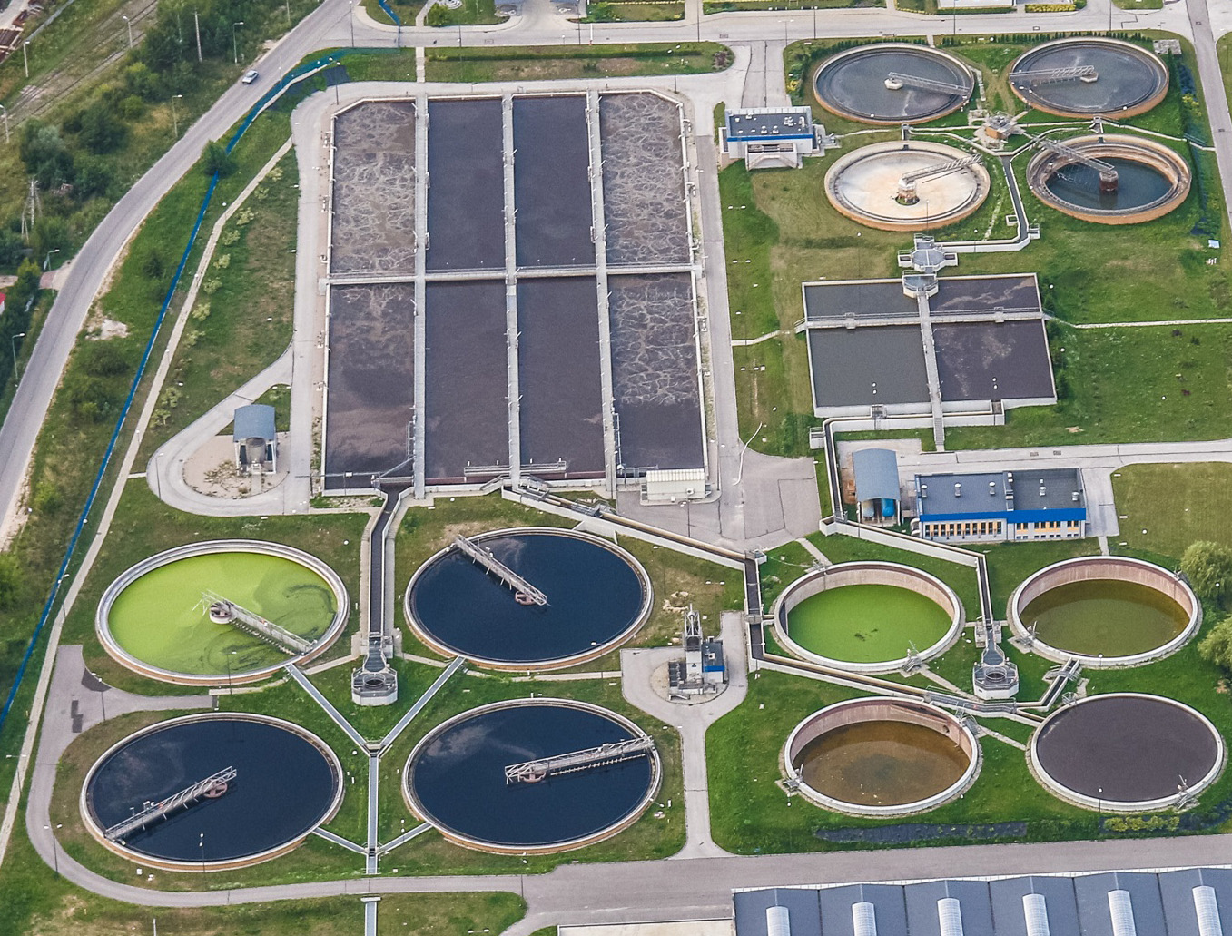
Introduction
Processing involves a high input of energy and operating resources, which means high costs for the landfill

Slide 5
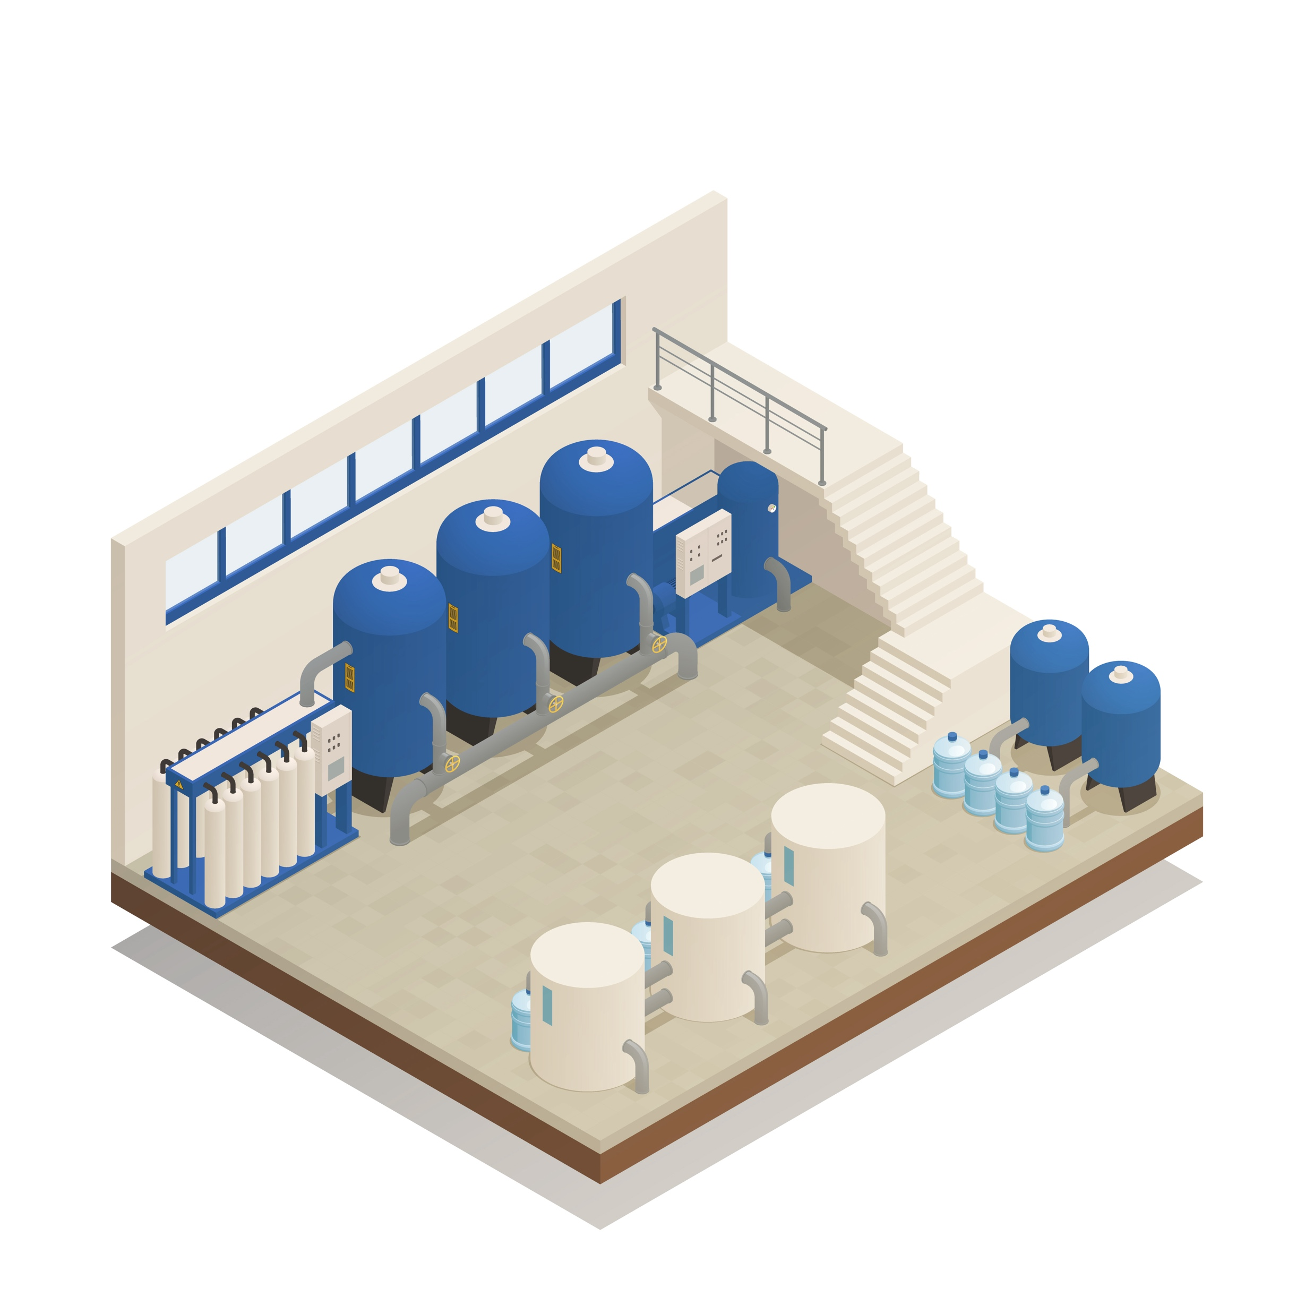
Use Case
Process step activated carbon filter
5 activated carbon filters in a row
Bypass after filter 2
Mixture after filter 5

Slide 6
Use Case
Process step activated carbon filter

Slide 7


Use Case
Process step activated carbon filter

Slide 8


The Model
Requirements & Essential criteria
Requirements:
Reliable predictions for more economical use of the filters by an efficient regulation of the bypass
Essential criteria:
Compliance with the legal limit
Avoidance of fines

Slide 9

The Model
Set up
Trained with 59,321 historical entries
Used multiple Regression models:
Support Vector Machine (0.3%)
Random Forest Regression (0.7%)

Slide 10
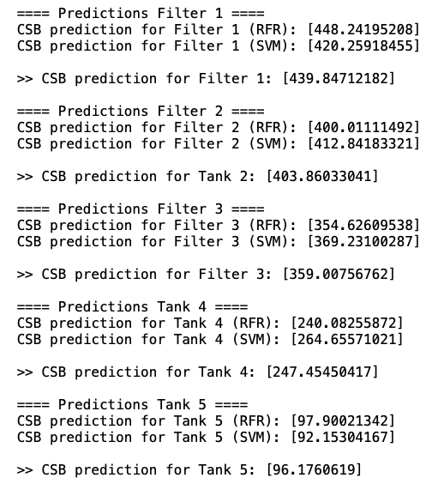
The Model
Performance
Model Predictions
Prediction | Original | Error
439.85 | 457 | - 3.75 %
403.86 | 427 | - 5.42 %
359.01 | 368 | - 2.44 %
247.45 | 282 | - 12.25 %
96.18 | 87 | + 9.55 %

Slide 11
Thanks for you attention!

